Slide 1

Demystifying AI and Machine Learning
A/Prof Richard Xu
UTS Faculty of Engineering & IT
30/Aug/2018

Slide 2
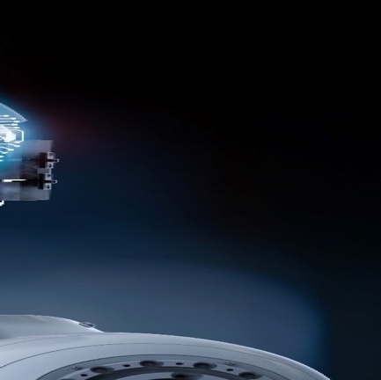
AI in a day.
UTS :: FEIT :: Richard Xu
08
Self-driving car
07
Finance security
Drunk and
go home
Pay
for dinner
06
Recommendation
system
01
Face recognition
Unlock
iPhone X
Choose
where to eat
Ask
Siri/Echo
Translation
02
Audio recognition
05
Nature Language
processing
Check
emails
Google map
navigation
03
Intelligence transports planning
04
Spam filtering

Slide 3
Applications of AI & ML – just from our lab’s industry’s engagement alone
UTS :: FEIT :: Richard Xu
Product range modelling
Smart city applications
Customer segmentation
CityRail Bus replacement optimization
Predictive inventory/maintenance
Injury prediction
Recommendation system
Peer-to-peer lending ranking
Personalized email/campaign
Process optimization
Product correlations
Education-to-job alignment
Transport passenger prediction
Real-time strategy for defense
HR performance indictor prediction
Network traffic modelling
Sentiment analysis
Chabot
…
…

Slide 4
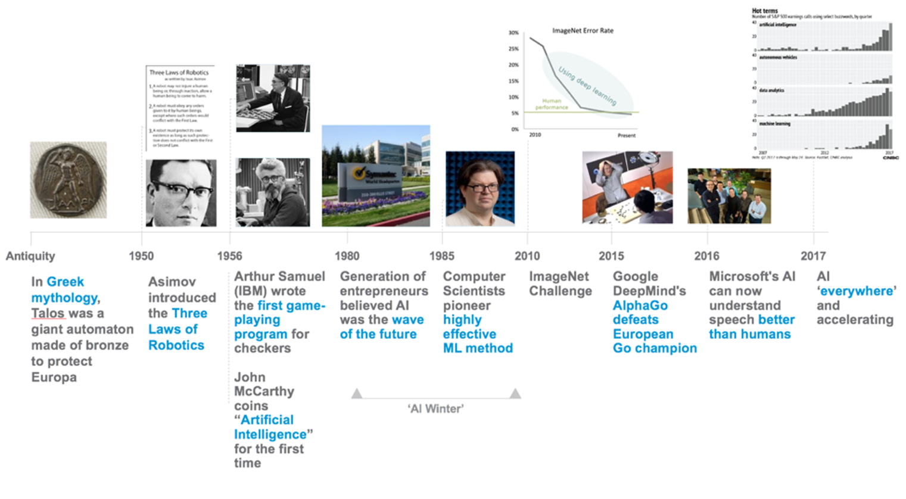
AI’s Developments
UTS :: FEIT :: Richard Xu
Image credit: VMware Xplorer Group

Slide 5
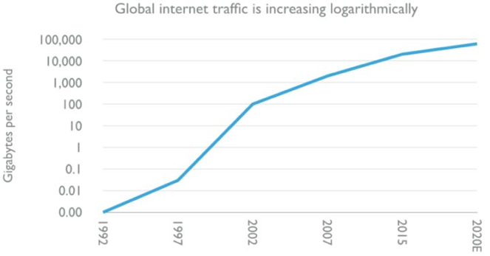
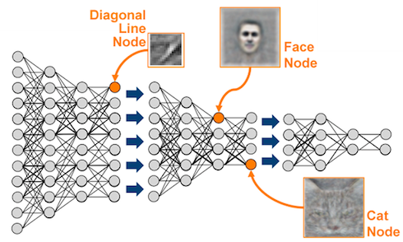
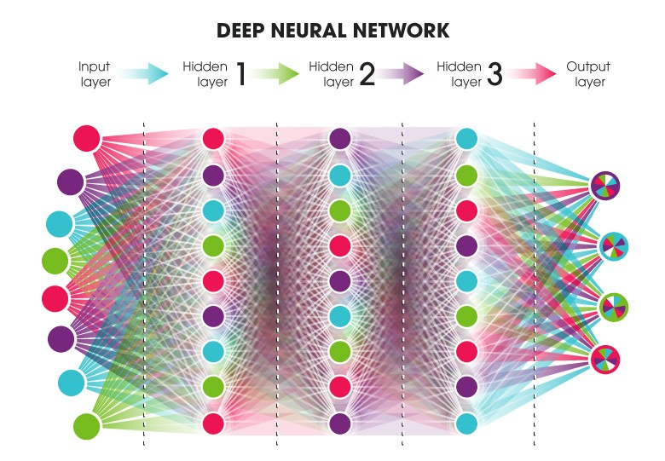
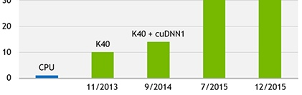
AI :why does it rise recently?
UTS :: FEIT :: Richard Xu
Huge amount of Data
Better algorithms
Much powerful GPU
Image credit: David Kelnar at Medium.com and NVIDIA

Slide 6
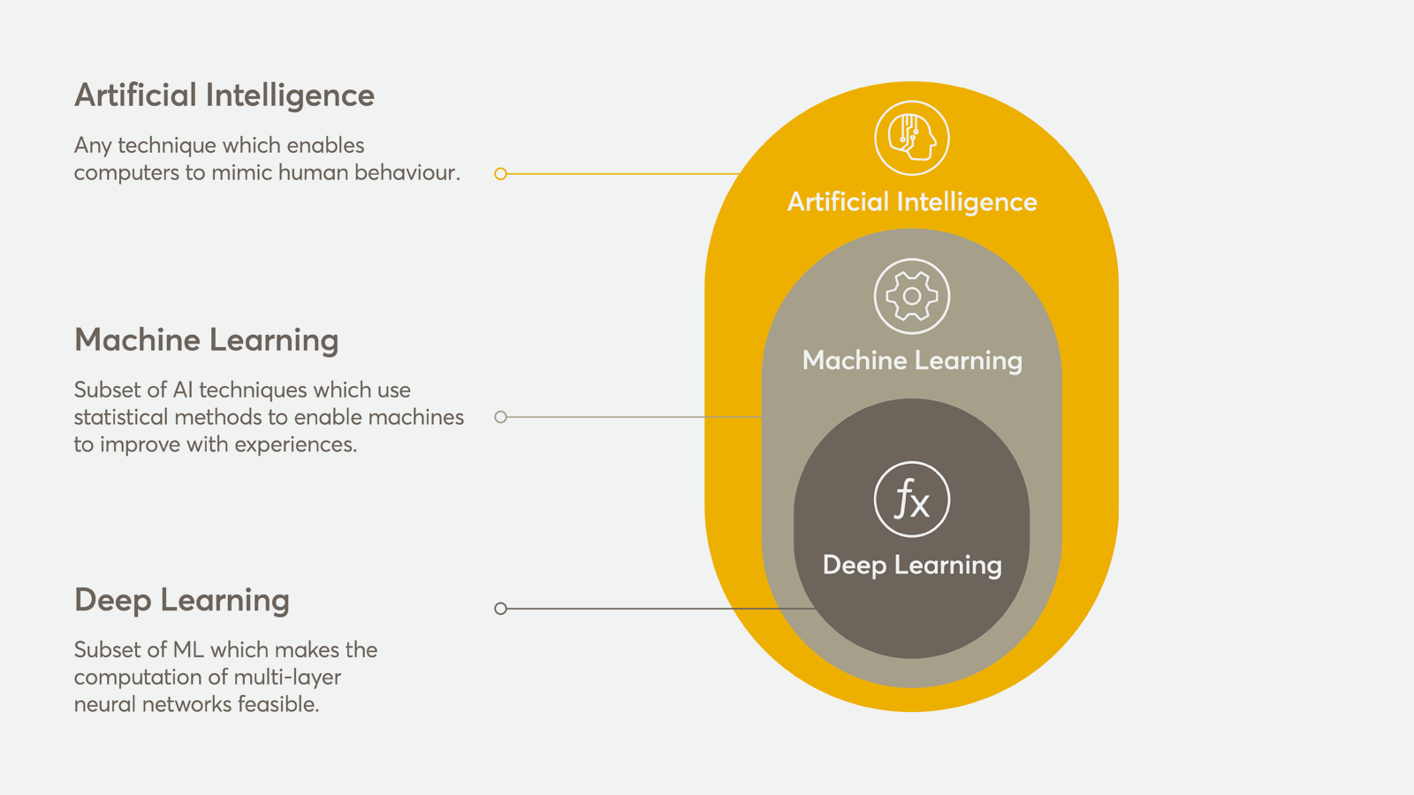
Buzzwords: AI, ML & DL
UTS :: FEIT :: Richard Xu
Image credit: NASTEL

Slide 7
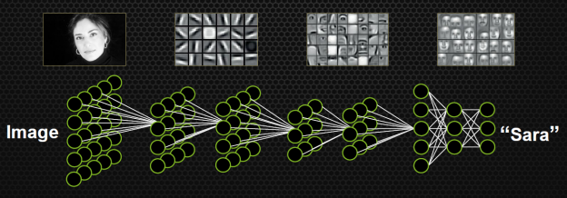
Convolutional Neural Network
UTS :: FEIT :: Richard Xu
More details are found on my Machine Learning notes:
https://github.com/roboticcam/machine-learning-notes/blob/master/cnn_beyond.pdf
Image credit: NVIDIA

Slide 8
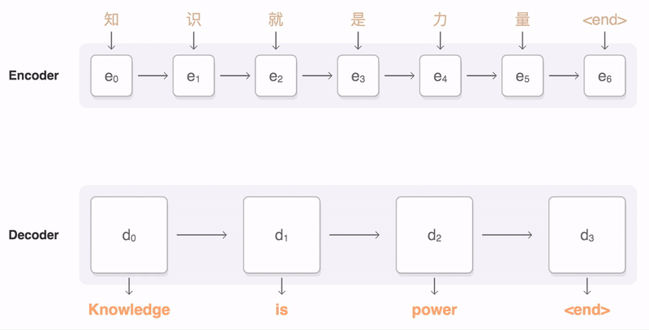
Recurrent Neural Network
UTS :: FEIT:: Richard Xu
Chinese
English
Image credit: Google Research

Slide 9
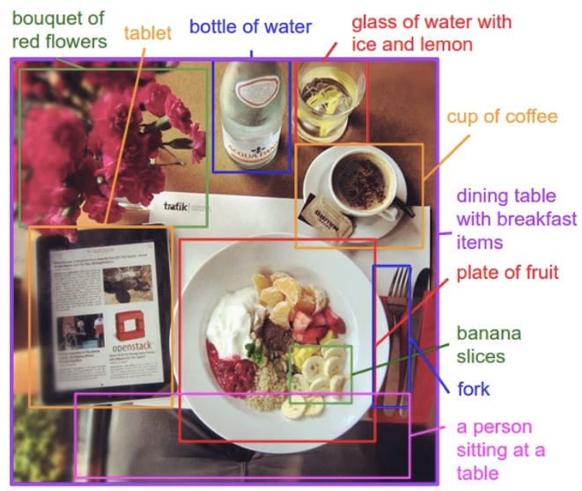
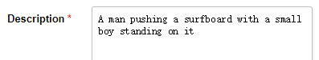


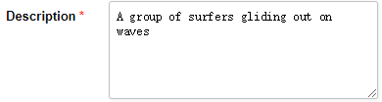

AI applications:
UTS :: FEIT :: Richard Xu
Present:
Stanford’s automated image part description generation
UTS’s work in text description to image
Future:
Image credit: Stanford vision lab
AI to create a full featured movie from a movie script

Slide 10
AI applications:
UTS :: FEIT :: Richard Xu
Present in NLP:
Washington Post’s robot reporter has published 850 articles in 2017
UTS::Deep Learning job advertisement generator
Salesforce’s AI research Seq2SQL: Generate Structured Queries from Natural Language using RL
UTS::DeepLearning NLP to OPAL query
Future in NLP:
Produce the world’s best selling ( in cryptocurrency ☺) novel

Slide 11


AI applications:
UTS :: FEIT :: Richard Xu
Present AI music:
SONY CSL Research Lab created first-ever entire songs composed by robot: Daddy's Car
Google’s AI song
Amy Bot (Richard’s lab Intern) – two hand’s piano play form left-hand play
-Left hand
-Left hand + Right hand
Future AI music:
AI compose a set of viral songs, i.e., AlanWalkerBot
All information stored in SQL
Produce the entire script

Slide 12
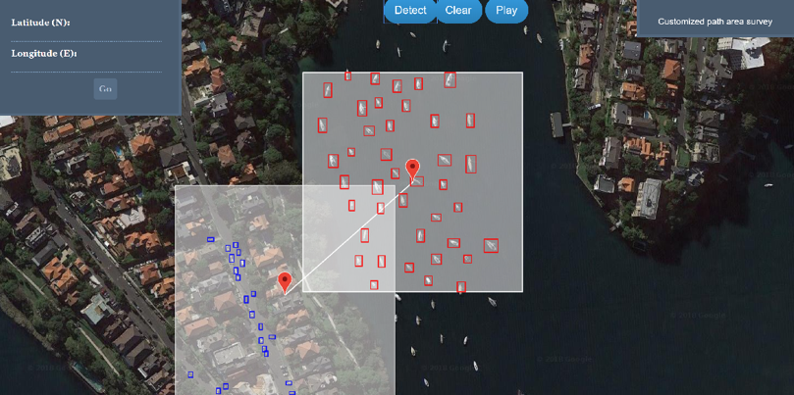
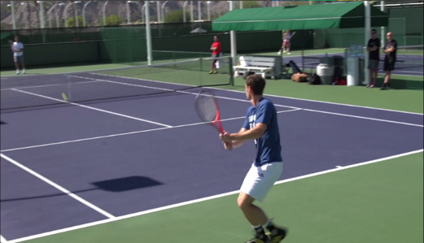
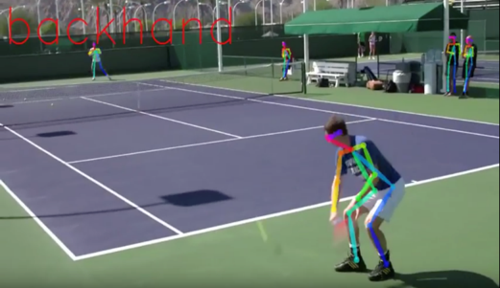
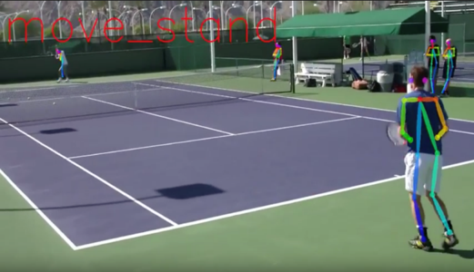
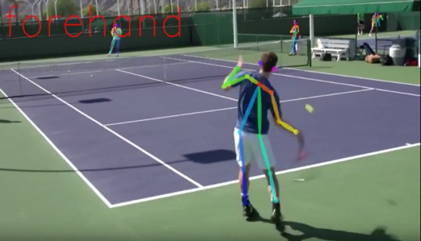
AI applications:
UTS :: FEIT :: Richard Xu
Present AI computer vision:
IBM Watson produced a trailer for Morgan by learning by feeding more than 100 horror film trailers
Adobe’s assisted paining robot
UTS automated boat and car counting
Future AI computer vision:
UTS automated tennis stats collection (YouTube link)
Produce a full featured film

Slide 13
AI applications:
UTS :: FEIT :: Richard Xu
Present AI retail:
Facebook Messenger platform uses AI to replace traditional customer service representative
UTS is working on fashion trend prediction and new GAN based style generation
Fashion Landmark detection
Trend-driven style generation
Future AI computer vision:
Produce an entire AI-driven shopping experience

Slide 14
AI applications:
UTS :: FEIT :: Richard Xu
Game/adversarial/defense:
Google AlphaGo/AlphaGo Zero
UTS real-time strategy game for defense
Future AI-powered defense:
World will be in peace and harmony

Slide 15


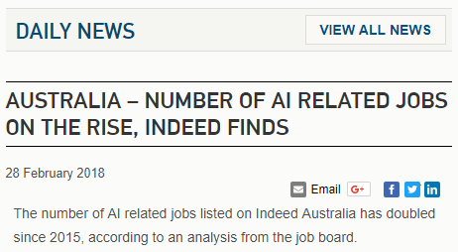
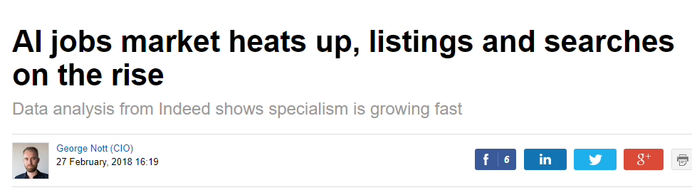
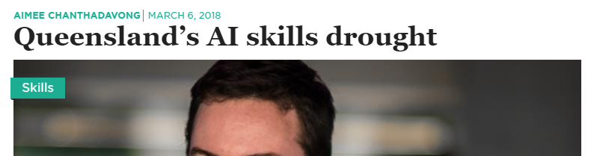
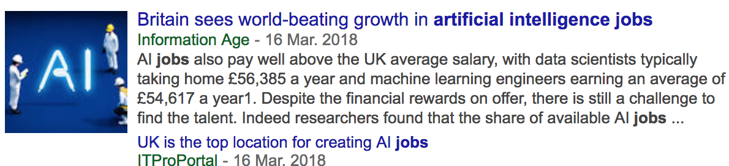
AI Talent hunting
UTS :: FEIT :: Richard Xu

Slide 16

UTS
Faculty of Engineering & IT
THANK YOU
Al will make the world better.

